Slide 1
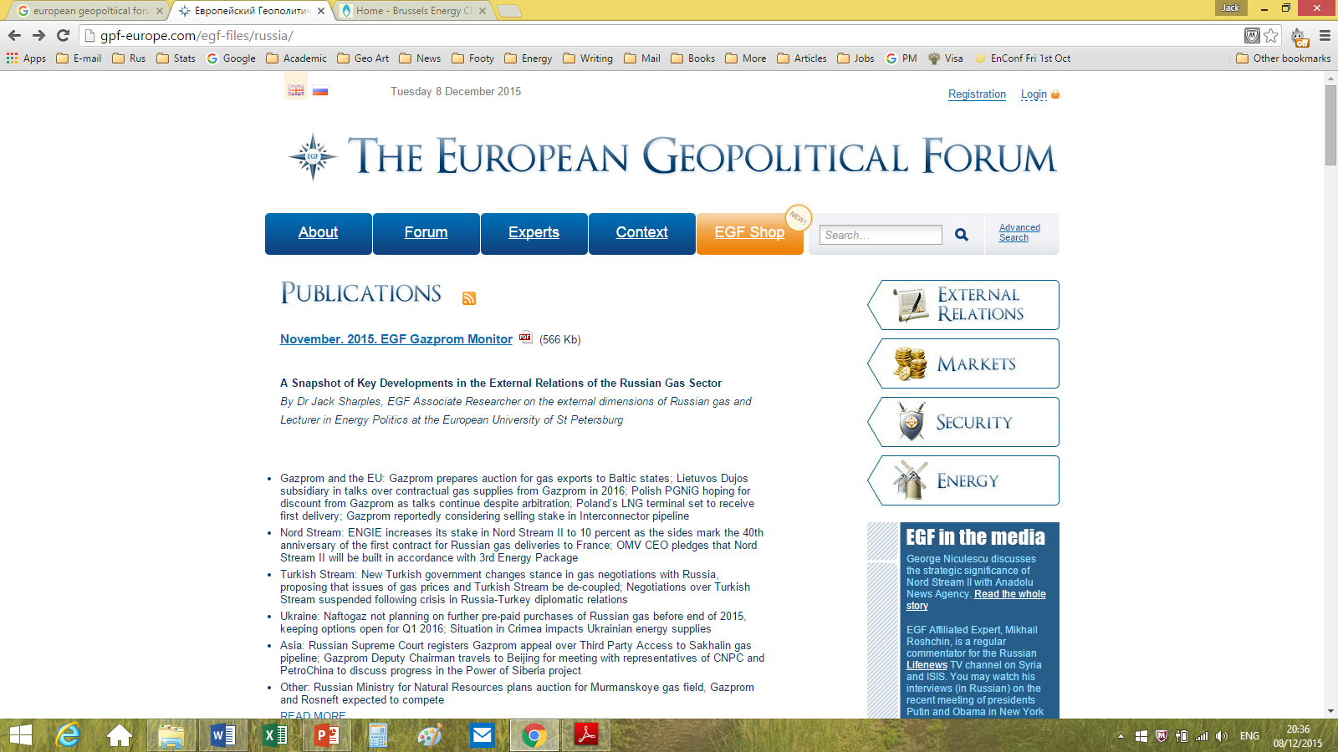

Oil and Gas Supplies in Eurasian Energy Security to 2030 Energy Charter Executive Training Programme International Oil & Gas University, Ashgabat, Turkmenistan 1st-2nd June 2017
Dr Jack Sharples
European University of St Petersburg
https://eu-spb.academia.edu/JackSharples

Slide 2
Eurasian Energy Security

Slide 3
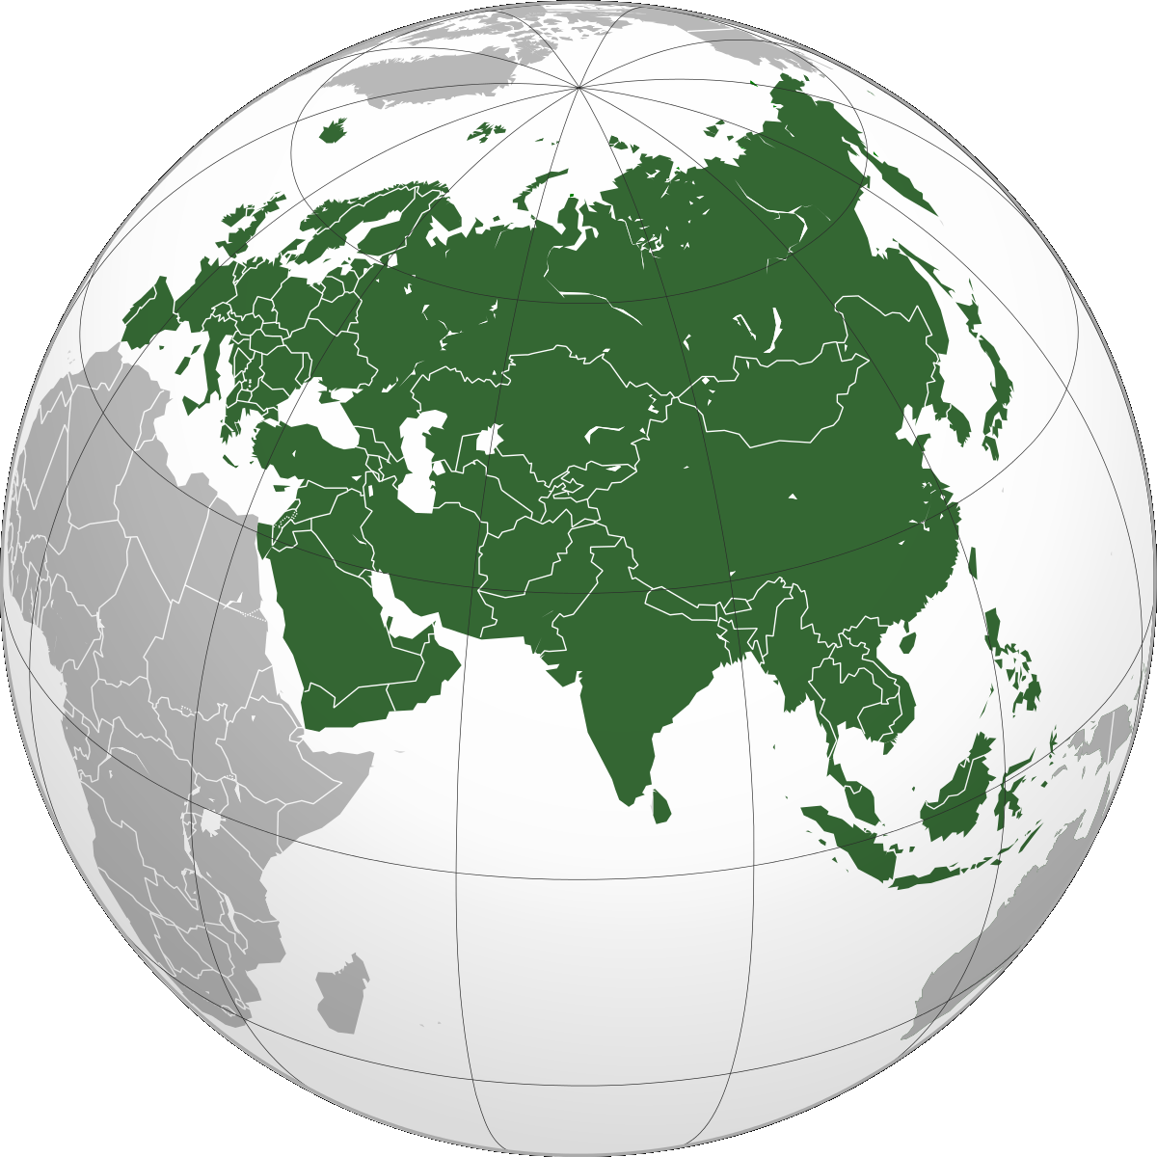
Defining Eurasia
The Eurasian continent covers:
36% of global landmass
70% of global population
Particular focus on Russia, Turkmenistan, & Kazakhstan as an ‘energy bridge’, between Europe to the West and Asia to the East

Slide 4
The Concept of Energy Security
Energy Security as a multi-part concept:
Available/accessible supplies
Reliable/uninterruptible supply
Competitive/affordable price
Environmentally sustainable
How can these four elements be applied to Eurasia?

Slide 5
Availability of Energy Supplies

Slide 6

Availability of Energy Supplies
Availability means ability to meet demand using a combination of domestic production & foreign imports
If I cannot produce enough at home, can I buy what I need on the international market?
Price is not a factor, only physical availability
How ‘available’ are energy supplies, at global & Eurasian levels?

Slide 7
Global Availability of Energy Supplies in 2015
 | Oil (mb/d) | Gas (bcm) | Coal (mt)
Production | 91.7 | 3,539 | 7,709
Demand | 95.0 | 3,468 | -
Exports | 61 | 1,042 | 1,200
World Primary Energy Consumption by Fuel (mtoe)
Oil | Gas | Coal | Nuclear | Hydro | RES | Total
4,331 | 3,135 | 3,840 | 583 | 893 | 365 | 13,147
33% | 24% | 29% | 4% | 7% | 3% | 100%
Data sources: BP Statistical Review of World Energy; IEA Key World Energy Statistics

Slide 9
Availability of Energy Supplies
Globally, oil, gas, and coal are the most-consumed fuels
Share of global consumption that is traded across borders: Oil (66%); Gas (30%); Coal (15%)
Eurasia has some of the world’s largest energy exporters:
Russia as 2nd largest oil exporter (after Saudi Arabia)
Russia & Turkmenistan in top 4 largest gas reserves
Russia as № 1 gas exporter (Turkmenistan № 5)
Russian gas supplies to Europe and Turkmen supplies to China
Russia № 3 coal exporter (Kazakhstan № 7)
Kazakhstan alone accounts for 40% of world uranium production

Slide 10
Availability of Energy Supplies
These exporters find natural markets to the West and East:
Russian oil exports to Europe and Asia
Russian gas supplies to Europe and Turkmen gas supplies to China
Russian coal to Europe and China
Kazakh uranium is exported around the world
The major European countries, China, India, Japan, and South Korea are major energy importers:
These importing countries also have the possibility of importing oil, coal, and gas from competing suppliers
Especially from the Middle East (oil and gas), Asia-Pacific (gas and coal)

Slide 11
Availability of Energy Supplies - Imports
In 2015, the EU imported 553 million tonnes of crude oil
153mt (28%) was sourced from Russia, 35mt (6%) from Kazakhstan, and 27mt (5%) from Azerbaijan
In 2015, the EU imported 305 bcm of natural gas
122 bcm (40%) was sourced from Russia
In 2015, China imported 336 million tonnes of crude oil
42mt (12.5%) was sourced from Russia, and 5mt (1.5%) from CIS
Russia emerged as largest supplier of crude oil to China in 2016
In 2015, China imported 60 bcm of natural gas:
28 bcm (47%) by pipeline from Turkmenistan and 26 bcm (43%) as LNG

Slide 12
Availability of Energy Supplies - Exports
Of Russia's oil exports of 254mt: 159mt (63%) to Europe, 42mt to China, 25mt to Japan and other A-P, 23mt (9%) to other CIS
For other CIS (81mt): 56mt (69%) to Europe, 5mt to China, 6mt to other A-P, and 7mt to Middle East
In 2015, Russia supplied c.10% of Japanese and South Korean gas imports, while Turkmenistan supplied almost half of China’s
Other than this, ‘Eurasian’ gas exports are almost exclusively directed to Europe or former Soviet states
Eurostat nrg_123a; Eurostat nrg_124a; BP Statistical Review 2016

Slide 13
Availability of Energy Supplies
This tells us that the ‘Eurasian Energy Balance’ in terms of oil and gas is tilted towards Europe
‘Asian’ part of Eurasia also receives oil and gas from Middle East and A-P
Turkmen gas supplies to China are currently the exception
Russia plans to develop its own gas supplies to China (Power of Siberia)
East Siberia-Pacific Ocean (ESPO) pipeline is currently under expansion, from 30mtpa to 50mtpa (increasing oil exports to China by 50%)
Eurasia has high ‘availability’ of energy supplies within its own region, and access to non-regional energy supplies
Availability requires infrastructure for delivery

Slide 14
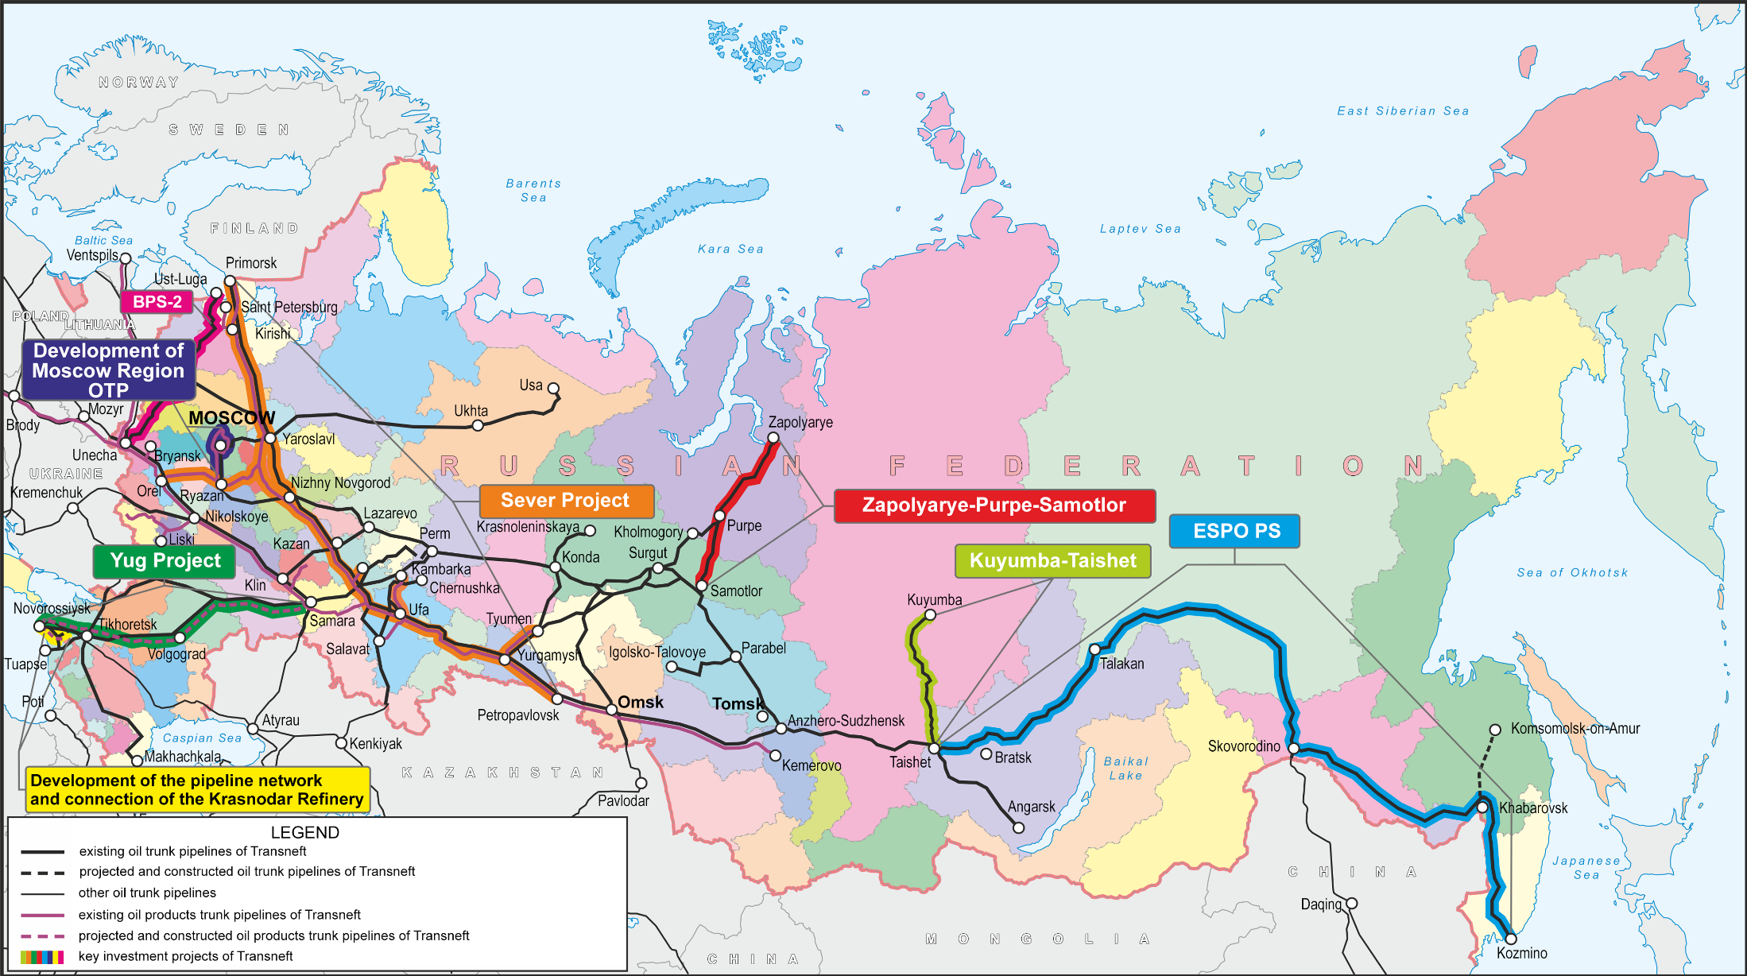

Slide 15
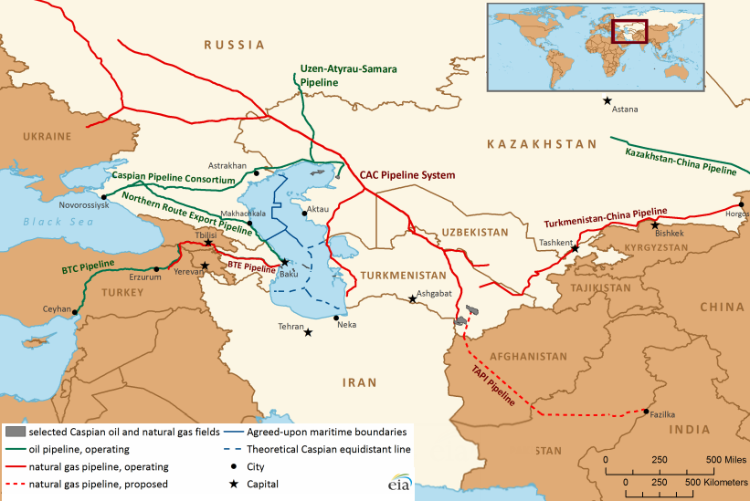

Slide 16
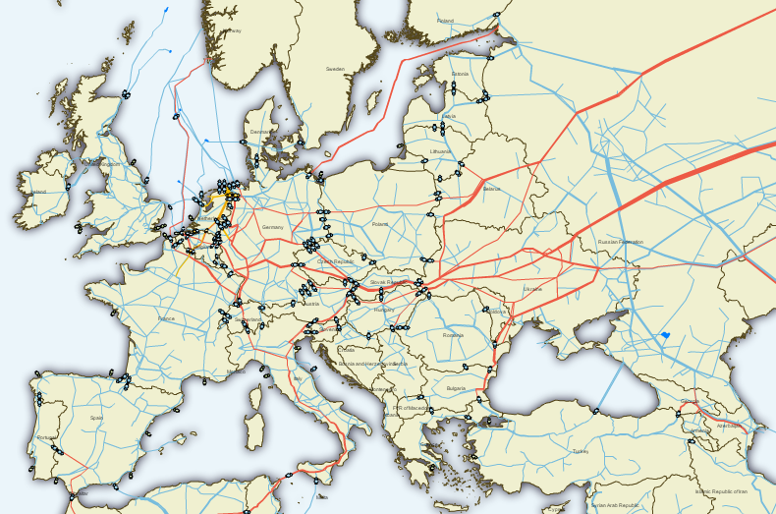

Slide 17
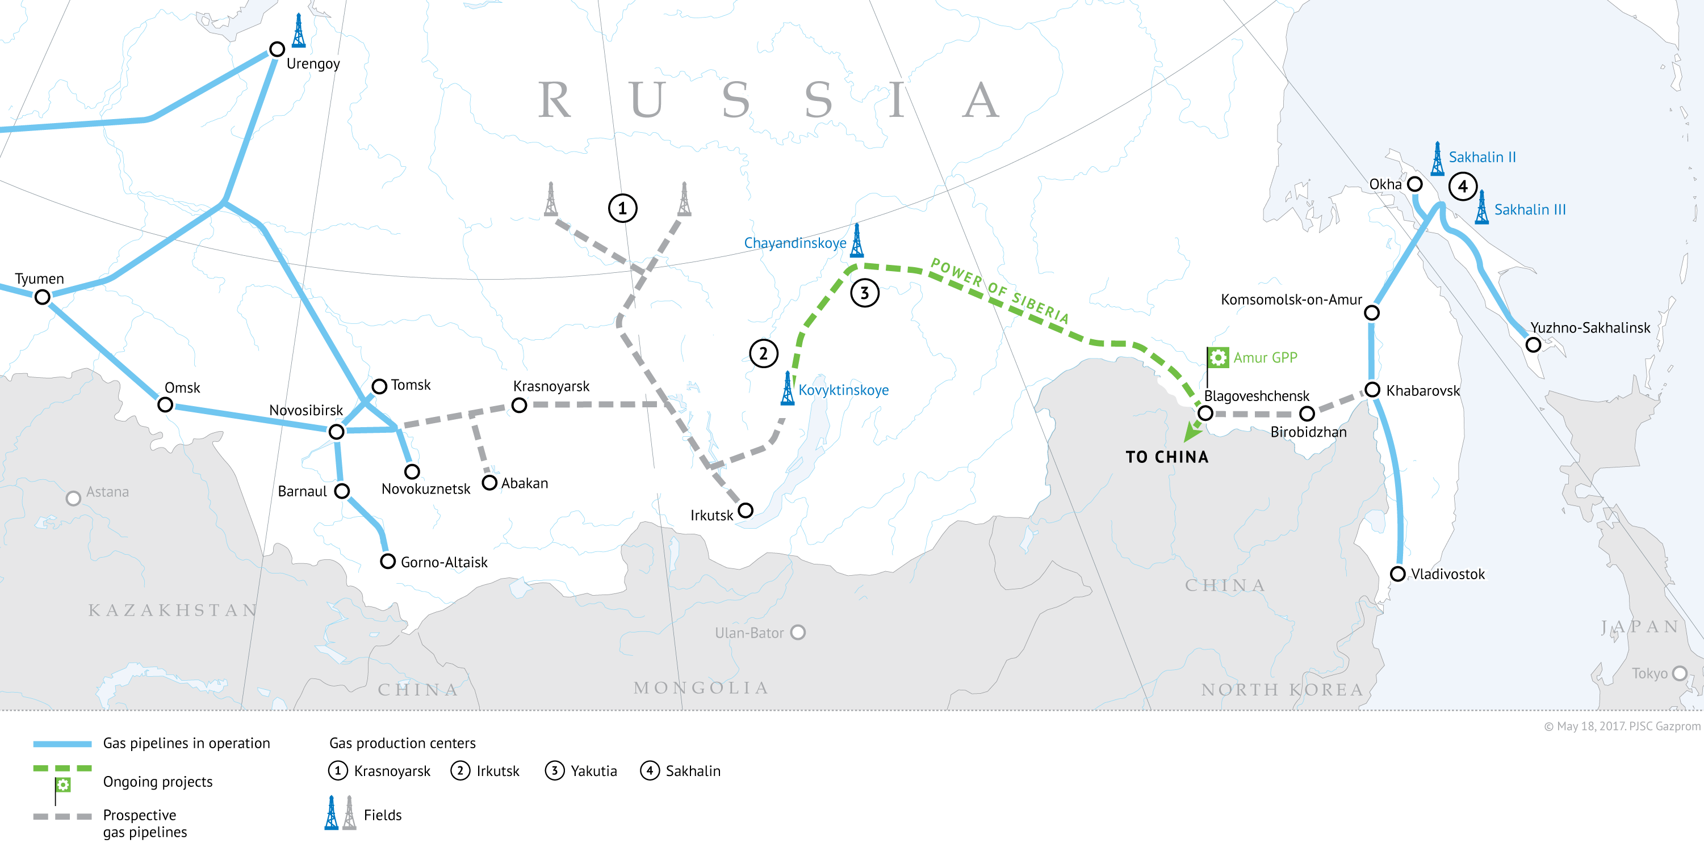

Slide 18
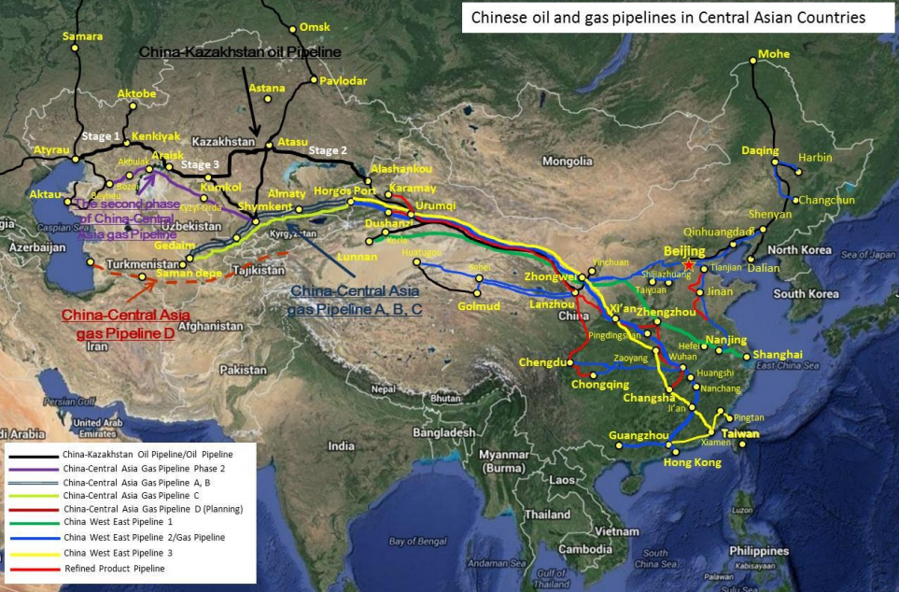

Slide 19
Availability of Energy Supplies
Looking to the future, the availability of energy in Eurasia will depend on trends in energy demand and energy production
In Europe & Russia, oil & gas demand is growing only incrementally, given increasing energy efficiency, moderate growth in GDP and population, and growing role of RES
Japan and South Korea are also ‘mature’ energy markets
Major growth in energy demand is in China & India
Oil and gas from Russia and Turkmenistan will be crucial for meeting their energy needs

Slide 20
Reliability of Energy Supplies

Slide 21
Reliability of Energy Supplies
Reliability of energy supplies is ensured by:
Good relationship with wholesale energy supplier
Reliable international transit from supplier to consumer
Further safeguard is provided when importers have access to:
Supplies of a single fuel from multiple suppliers
Supplies of multiple types of fuel, for power generation
If supply of a single commodity from the primary supplier is interrupted, the importer can switch to alternative supplies
Supplies delivered via fixed infrastructure (pipelines) are more vulnerable than flexible supplies (oil or LNG tankers)

Slide 22
Potential or Actual Supply Disruptions
Political: OPEC oil embargo of 1973-74 and Iranian threats to close the Strait of Hormuz (Feb 2015)
Conflict (Iranian Revolution, Iran-Iraq War, Gulf War I & II, Libya since 2011)
Terrorist attack on Algerian Tigantourine gas production facility (2013)
Piracy off the coast of Somalia (largely ceased since 2012) and in the Strait of Malacca (increasing in recent years)
Russia-Turkmenistan pipeline explosion in April 2009
Russia-Ukraine gas disputes & transit interruptions (2006, 2009)
High domestic demand limited Russian gas exports to Europe (Feb 2012)
Technical difficulties at gas producing fields can cause supply interruptions (Norwegian gas supplies to the UK, January 2010 and June 2016)

Slide 23
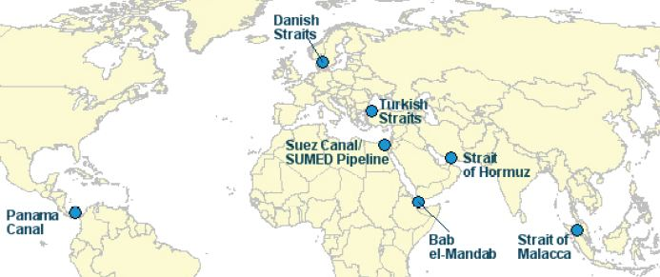
Potential or Actual Supply Disruptions

Slide 24
Reliability of Energy Supplies
We should remember that substantial interruptions are rare
Even when interruptions do happen, their effects are often localized, rather than regional
Impact of Jan 2009 crisis on Central Europe and Balkans
While complete interruptions in supplies are rare, partial interruptions in supplies result in price increases
Oil price spikes in 1973-74, 1979, and increases post-2003 and -2011
Short-term gas hub price spikes linked to Feb 2012 shortage and brief interruptions in Norwegian supplies to the UK

Slide 25
Competitively-Priced Energy Supplies

Slide 26
Competitively-Priced Energy Supplies
In an ‘ideal’ world, levels of supply and demand are approximately equal, with excesses of supply or demand causing a slight price fluctuation that either increases demand and reduces production, or vice-versa, re-stablishing equilibrium
Complicating factors:
Same fuel can have different production costs and qualities
Sweet or sour? Light or heavy oil? Wet or dry gas?
Not all supply options can be easily delivered (location)
These different factors are reflected in different ‘base’ prices

Slide 27
Competitively-Priced Energy Supplies
The major benefit of having a range of potential suppliers is more competitive pricing of supplies
So how competitive are supplies in Eurasia?
In the West, the European oil and gas market is served by competing suppliers from Eurasia, North Africa, Middle East, and beyond
In the East, the Asian oil and gas market is also served by competing suppliers from Eurasia, Middle East, and Asia-Pacific region
Localised monopolies are being overcome by regional market integration – Example of Baltic & Central European gas market

Slide 28
Competitively-Priced Energy Supplies
In an ‘ideal’ world, levels of supply and demand are approximately equal
Excesses of supply or demand cause a slight price fluctuation that encourages either increased demand and reduced production, or vice-versa, thus re-stablishing the price equilibrium
Complicating factors:
Same fuel can have different production costs and qualities
Sweet or sour? Light or heavy oil? Wet or dry gas?
Not all supply options can be easily delivered (location)
These different factors are reflected in different ‘base’ prices

Slide 29
Competitively-Priced Energy Supplies
The minimum price of a commodity is the price at which it can be produced and delivered to the consumer (cost-plus)
The maximum price is based on price of competing fuels:
For natural gas, this refers to coal, nuclear, and RES in power generation
Substitution of oil is difficult, especially in transportation
This lack of ‘elasticity’ means that, if oil prices rise too high, consumers are forced to either reduce their activities or adapt to high prices
Consumers are remarkably adaptable in relation to price levels
From 2011 to 2014 oil prices remained above $100/bbl, yet global oil consumption continued to grow

Slide 30
Competitively-Priced Energy Supplies
Producers and consumers can adapt to virtually any price level
Volatility of prices is a far greater concern:
Long-term low prices encourage demand and reduced production
Long-term high prices encourage alternative production and development of alternative fuels (e.g. Electric or gas-based transport)
But how can producers and consumers plan when prices are volatile?
From mid-1980s-late 1990s oil prices were low and stable
From 2000 to 2006, oil prices rose steadily
Decade between 2006 and 2016 saw unprecedented oil price volatility

Slide 32
Competitively-Priced Energy Supplies
Causes of oil price volatility:
Fundamentals of supply and demand, exacerbated by paper oil market
Excessive peak of 2007-2008 caused by speculation
Collapse in H2 2008 the bursting of ‘speculation bubble’
Price recovery based on fundamentals (2010-2014)
Sustained high prices encouraged new supplies, which came online just as global economic growth was slowing (esp. in China)
Since then, producers have been cutting costs for existing production, and FIDs for major new projects have been postponed
Will companies make major investments at $40-60 a barrel?
If not, we could see another supply crunch and price spike

Slide 34
Oct 2006: $60
Oct 2007: $82
Oct 2008: $72
Oct 2009: $73
Oct 2010: $83
Oct 2011: $110
Oct 2014: $87
Oct 2015: $48
Oct 2016: $50

Slide 35
Competitively-Priced Energy Supplies
Volatility of prices is a far greater concern:
Development of oil and gas fields is capital intensive, with long payback periods – In an environment of uncertain costs and revenues, companies will delay investment
Industrial consumers also cannot plan their costs (for example, airlines planning the cost of jet fuel)
Difficult to assess the relative cost of competing fuels
Price volatility also has a negative impact on the national budgets of energy-exporting countries
This requires the use of a ‘Stabilisation Fund’, but governments are under popular pressure to spend their oil revenues

Slide 36
Competitively-Priced Energy Supplies
Gas pricing based on oil prices or competition at trading hubs
Absolute price more of a problem than with oil, because gas competes with other fuels in power generation:
Increasing role of electricity in 21st century
In Europe, gas ‘squeezed’ between relatively cheaper coal and subsidized RES – key role of carbon policies and taxes
In the East, gas struggles to compete with coal (China & India)
Future ‘affordability’ of natural gas will depend on national tax policies (carbon tax), level of subsidies for RES, and technological advances (such as development of methane hydrate)

Slide 37
Sustainable Energy Supplies

Slide 38
Environmentally Sustainable Energy Supplies
Sustainability is a relative, rather than absolute, concept
No modern energy consumption is completely sustainable
Environmental impact of energy consumption:
Combustion of hydrocarbons generates CO2 and pollution
Nuclear power generation leaves behind nuclear waste
Wind turbines & solar panels require precious metals for construction
How to dispose of (or recycle) batteries from electric vehicles?
Gas produces less CO2, Sulphur, and fine particles than coal or oil, but it does still produce CO2 and methane itself is a potent GHG

Slide 39
Finite Fossil Fuels?
Sustainability also refers to the finite nature of fossil fuels
The reserve-to-production (R/P) ratio indicates how many years production could continue at current levels
R/P ratios of oil, gas, and coal at the global & Eurasian levels:
World: Oil: 50 years; Gas: 52 years; Coal: 273 years;
Europe & FSU: Oil: 25 years; Gas: 57 years; Coal: 114 years
New resources are being discovered every year. Since 1995:
Proven global oil reserves have grown from 1.1 to 1.7 billion barrels
Proven global gas reserves have grown from 120 to 187 bcm

Slide 40
Hubbert’s Curve
In 1956, Marion King Hubbert argued:
The production of oil must begin at zero and end at zero
The total production will be equal or less than proven reserves
Production of any given resource follows a bell curve
The total production will be distributed under the bell curve
Therefore, if we know the volume of proven reserves of an oil field and distribute the production from those reserves under a bell curve, we may roughly predict the annual production, cumulative production, and peak of production from that field
Hubbert, ‘Nuclear Energy and Fossil Fuels’, American Petroleum Institute at the Plaza Hotel in San Antonio, Texas (7-9/3/1956)

Slide 41
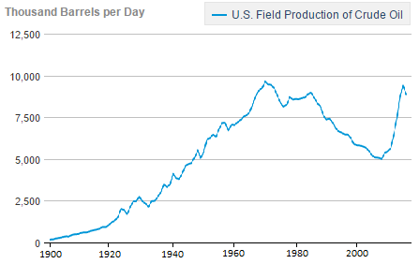

Slide 42
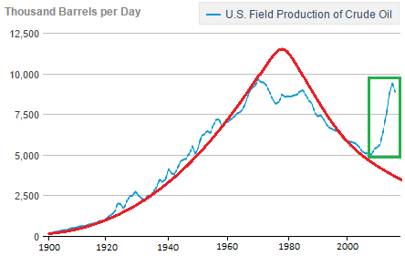

Slide 43
Delaying Peak Oil?
Hubbert’s Curve relies upon good data from conventional fields
Must be re-calculated every time new resources are discovered
Until 1990s, it accurately reflected conventional oil production
But does not take into account non-conventional resources:
Shale gas, coalbed methane, methane hydrate
Tight oil, shale oil, and oil sands
These new forms of oil and gas production are extending R/P ratios, but non-conventional reserves are harder to calculate
Non-conventional production is often more environmentally damaging than conventional production

Slide 44
Sustainable Energy Supplies
We must accept the fact that energy supplies are only relatively sustainable, and build a portfolio of energy supplies that balances considerations of:
Availability
Reliability (security of supply)
Price competitiveness
Environmental impact and sustainability
How is this question of sustainability being played out in Eurasia?

Slide 45
Sustainable Energy Supplies
In Europe, we can see dramatically different policies in different countries, depending on their particular circumstances:
Some countries continue to promote nuclear power (UK, France)
Some countries are phasing out coal-fired power generation (UK), while others see it as crucial (Poland)
Subsidies for RES (German Energiewende)
Some are enthusiastic about gas imports (UK, Germany) and others less so (Estonia, Finland, Bulgaria) – Question of market competitiveness?
Limited development of non-oil transportation on land (electric vehicles in Italy) but more in maritime (LNG shipping in the Baltic Sea)

Slide 46
Sustainable Energy Supplies
In the rest of Eurasia, we can see a ‘portfolio’ approach to the power generation mix:
China: Huge energy demand requires a mixture of coal (72%), hydro (19%), gas, nuclear, and RES (9%), rather than a choice between them
Russia: Similar retention of coal, expansion of nuclear, and use of hydro (49%), but more emphasis on gas (50%) and less on non-hydro RES
India: 75% of power generation from coal, plus 10% hydro and 5% gas, with the remainder a mix of wind, nuclear, oil & biofuels
Kazakhstan: Coal (72%), gas (19%), and hydro (8%) dominant
Turkmenistan is an exception: All power generation is from gas, and 2013 Energy Strategy foresees new gas-fired power generation

Slide 47
Conclusions

Slide 48

Energy Security ‘Check List’
Availability: Production of energy
Accessible: Infrastructure for delivery
Reliable: Likelihood of interruptions
Competitive: Market-based pricing
Affordable: Can consumers buy supplies
Stable prices: Short-term price volatility
Sustainable (I): Environmental impact
Sustainable (II): Non-finite resources

Slide 49
Conclusions: Eurasian Energy Security
Conclusions about Eurasian energy security to 2030:
Energy supplies in Eurasia are abundantly available, with the region home to major energy exporters
Substantial infrastructure network (pipelines, railways, ports) means that energy deliveries from multiple supplies are accessible
Flexibility of global oil and LNG markets mean that energy supplies are reliable, despite concerns over transit
Market development and new cross-border infrastructure means that oil and gas supplies are increasingly competitive
Relative affordability depends on taxation and cost of competing fuels

Slide 50
Conclusions: Eurasian Energy Security
Conclusions about Eurasian energy security to 2030:
Price volatility is (and will remain) a major concern
The impact of price volatility on investments could lead to a supply crunch and price spike: Volatility is the ‘new normal’
Expect to see ever-greater deployment of RES in import-dependent countries, although technology costs, local pricing, and the political will of national governments re: environmental policy are crucial
Power generation in Europe is becoming more sustainable
Rapidly-growing demand in China & India mean that they remain coal-dependent, despite growing gas-fired and renewable power generation

Slide 51

Conclusions: Eurasian Energy Security
Energy supplies are available, accessible, relatively reliable, and increasingly competitive, while increased deployment of RES reduces environmental impact
Question of affordability remains open to debate, while the lifespan of fossil fuels is being extended through deployment of new technology
Fossil fuel supplies remain finite, and new technology only increases the environmental impact of their production

Slide 52
Thank you for your attention

Slide 53
For More Information Please Contact: Dr Jack Sharples European University at St Petersburg European Geopolitical Forum jsharples@eu.spb.ru https://eu-spb.academia.edu/JackSharples http://eu.spb.ru/en/professors/13154-sharples-jack http://shop.gpf-europe.com/

